Slide 1
Deep Learning in Spark
Thy Nguyen, Aileen Bui

Slide 2
Background

Slide 3
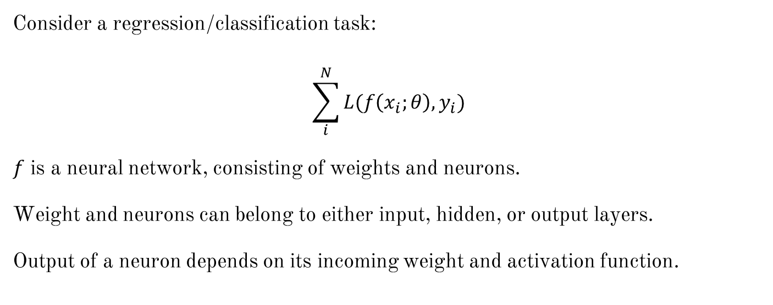
High-level Overview

Slide 4
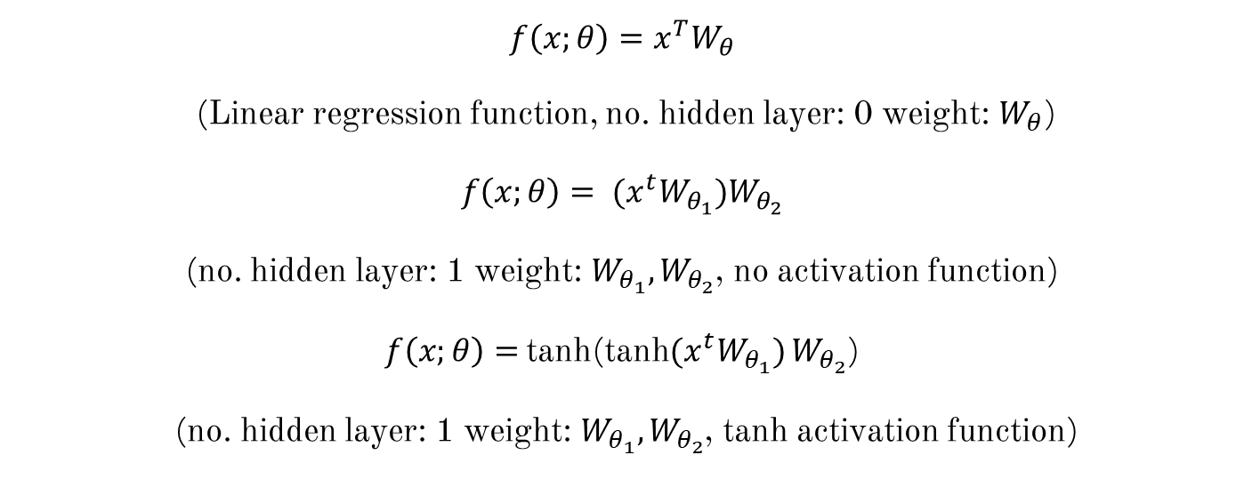
Simple Neural Network

Slide 5
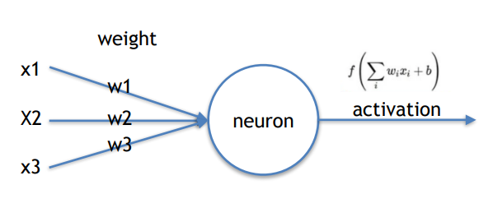


Slide 6
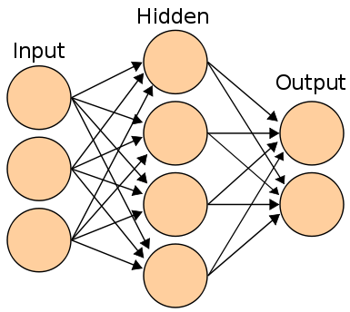

Slide 7


Slide 8
Deep Learning

Slide 9
Deep Learning
Deep Learning refers to model with a lot of hidden layers and parameters.
Deep learning typically refers to machine learning method that utilized Convolutional Network and Recurrent Network
1 hidden layer
2 hidden layers
Both can be actually considered non-deep network

Slide 10
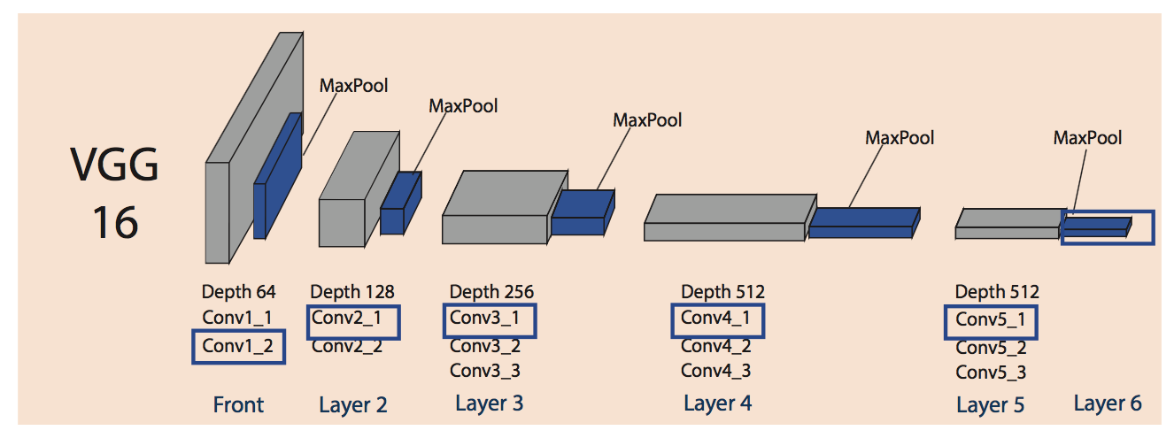
How large is Deep Model
138 Million parameter
6*9 + 9*4 = 90
8*9 + 9*9 + 9*9 +9*3 =261

Slide 11
Convolutional Network

Slide 12
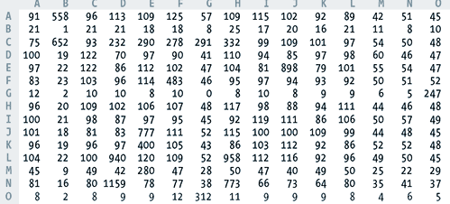
MLP works on tabular data (rank 1 data)
Prediction
CNN works on multi-dimensional data (rank 2 data)
Prediction

Slide 13
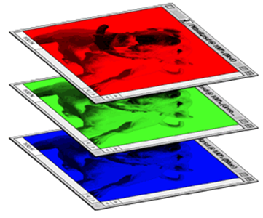
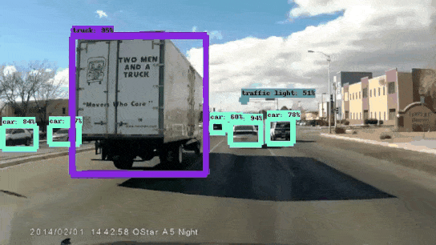
Color image
Rank 3 data
Rank 4 data

Slide 14
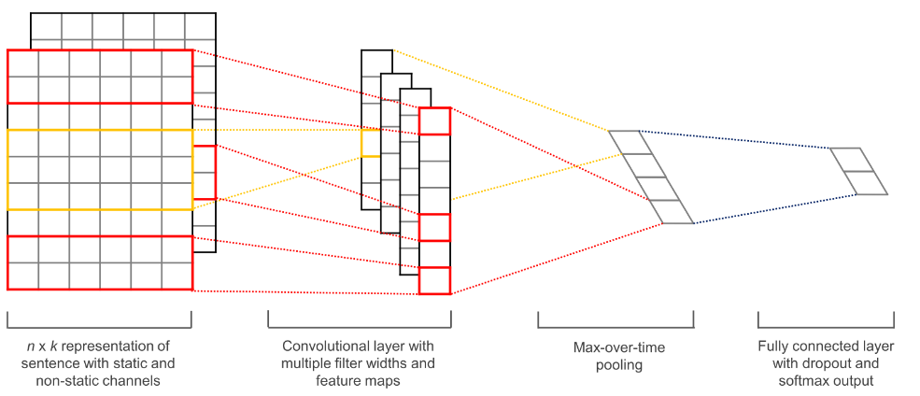
CNN architecture
CNN processed each color channel of a images and reduce the size of each channel in successive convolutional layer
After the 2-D shape of the channel got small enough, it is transformed into a 1-D vector
The resulting vector will be applied to a MLP for final prediction

Slide 15
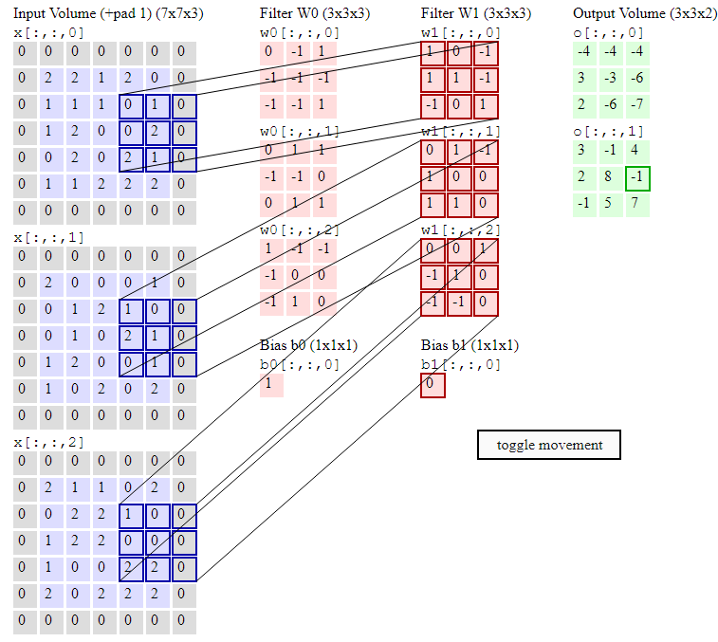
Convolutional Layer consists of filters applied on different local region of a channel.

Slide 16
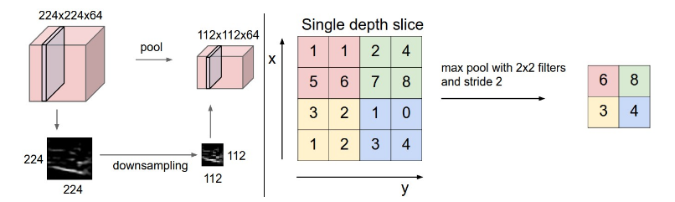
Pooling Layer progressively reduces the spatial size of the representation so one can obtain 1-D vector for final output

Slide 17
Training Neural Network

Slide 18
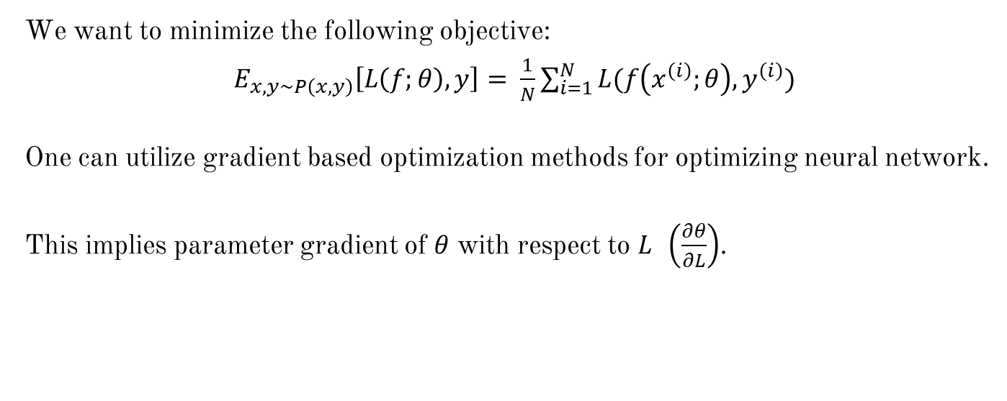
Optimization
We want to minimize the following objective:
$E_{x,y\sim P\left(x,y\right)}\left[L\left(f;θ\right), y\right]= \frac{1}{N}\sum_{i=1}^{N}{L(f\left(x^{\left(i\right)};θ\right),y^{\left(i\right)})}$
One can utilize gradient based optimization methods for optimizing neural network.
This implies parameter gradient of $θ$ with respect to $L$ $\left(\frac{∂θ}{∂L}\right)$.

Slide 19
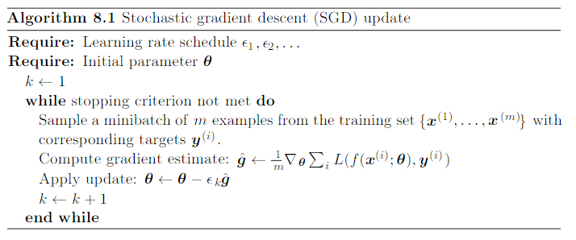
Batch sizes and learning rate affect performance

Slide 20
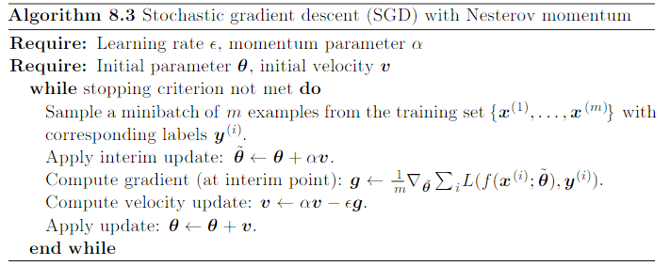
Momentum helps adjust learning rate
There are many methods to adapt learning rate
How to calculate gradient?

Slide 21
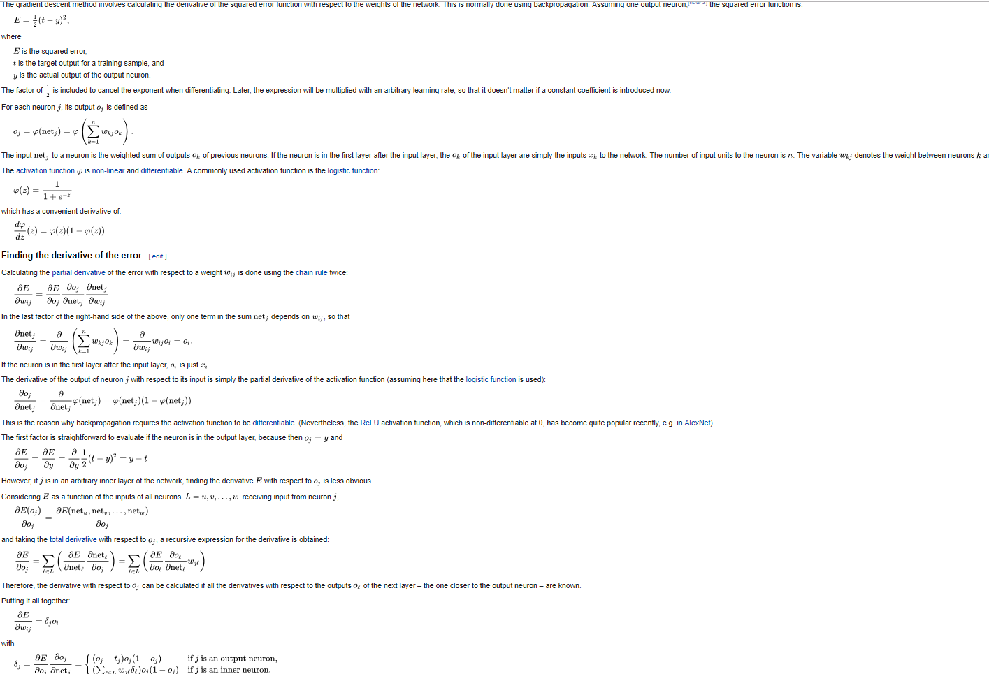
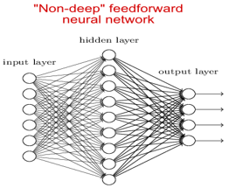
Manual calculation
Manual calculation of gradient for a small network is already tedious

Slide 22
Large architecture.

Slide 23
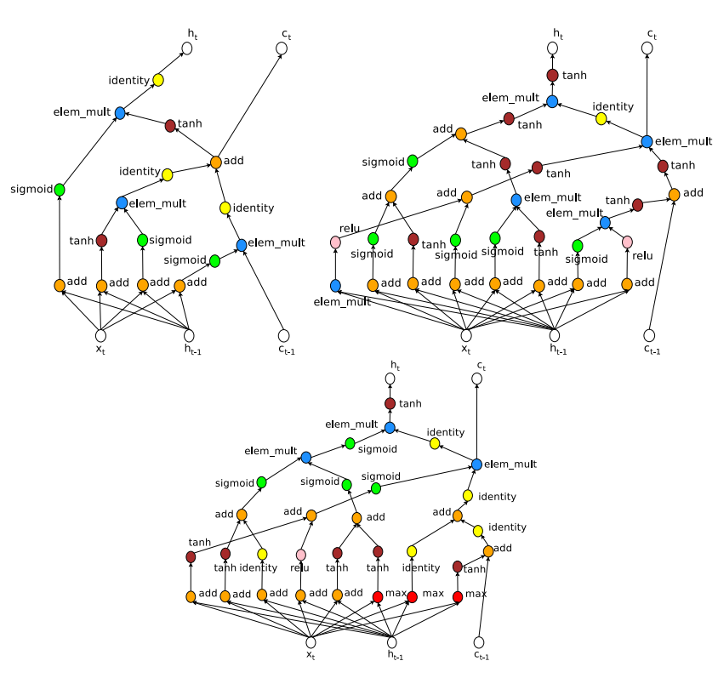
Large, convoluted architecture.
Automatic differentiation on graph

Slide 24

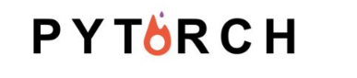

Automatic Differentiation

Slide 25
Deep Learning in SPARK

Slide 26
Why should we use Spark for Deep Learning
Fast in processing data (in-memory computing).
Unified engine for multiple things (run distributed SQL, create data pipelines, ingest data into a database, run Machine Learning algorithms, work with graphs, data streams and much more.)
High-level APIs to “democratize” the “superpower” of big data, enabling everyone to easily integrate scalable deep learning into their workflows, from machine learning practitioners to business analysts.

Slide 27
When should we use Spark for Deep Learning
Deep learning libraries are best used within Spark jobs for tasks such as:
Distributed inference: Each worker task makes predictions for a subset of instances.
Distributed model selection: Each worker task fits a model using a different set of training parameters. Each worker task uses a local dataset.

Slide 28
How to use Deep Learning in Spark
Inference
Featurization and transfer learning
Model training

Slide 29
How to use Deep Learning in Spark
Inference
Take a pretrained model on common datasets (e.g., Faster R-CNN, YOLO) then apply in parallel using a Spark function
Featurization and transfer learning
Model training

Slide 30
How to use Deep Learning in Spark
Inference
Featurization and transfer learning
Take an existing model as a featurizer to learn models for a new problem (transfer learning).
It generally involves the last few layers of the pretrained model and retrains them with the data of interest (which can be smaller size because it updates fewer parameters).
Model training

Slide 31
How to use Deep Learning in Spark
Inference
Featurization and transfer learning
Model training
Train a new deep learning from scratch. Two (02) common methods:
Parallelize the training of a single model over multiple servers
Train multiple instances of similar models in parallel, accelerating the model search and tuning process
* In case parallel training is not necessary, Spark libraries can be used to extract data and export it to a single-machine training script using native data format of frameworks (like TensorFlow).

Slide 32
Deep Learning Libraries in SPARK

Slide 33
Deep Learning Libraries in Spark
Library | Underlying DL framework | Use cases
BigDL | BigDL | Distributed training, inference, ML Pipeline integration
DeepLearning4J | DeepLearning4J | Inference, transfer learning, distributed training
Deep Learning Pipelines | TensorFlow, Keras | Inference, transfer learning, multi-model training, ML Pipeline and Spark SQL integration
Mlib Perceptron | Spark | Distributed training, ML Pipeline integration
TensorFlowOnSpark | TensorFlow | Distributed training, ML Pipeline integration
TensorFrames | TensorFlow | Inference, transfer learning, DataFrame integration

Slide 34
Example of Deep Learning Pipelines (DLP) in Spark
Deep Learning Pipelines provides high-level APIs for scalable deep learning by integrating popular deep learning frameworks with ML Pipelines and Spark SQL
Currently only offers an API in Python, which is designed to work closely with existing Python deep learning packages such as TensorFlow and Keras
Common aspects of deep learning can be done in a few lines of code!
Notes:
Spark DataFrames are a natural construct for applying deep learning models to a large-scale dataset.Deep Learning Pipelines provides a set of (Spark MLlib) Transformers for applying TensorFlow Graphsand TensorFlow-backed Keras Models at scale. In addition, popular images models can be applied outof the box, without requiring any TensorFlow or Keras code. The Transformers, backed by theTensorframes library, efficiently handle the distribution of models and data to Spark workers.

Slide 35
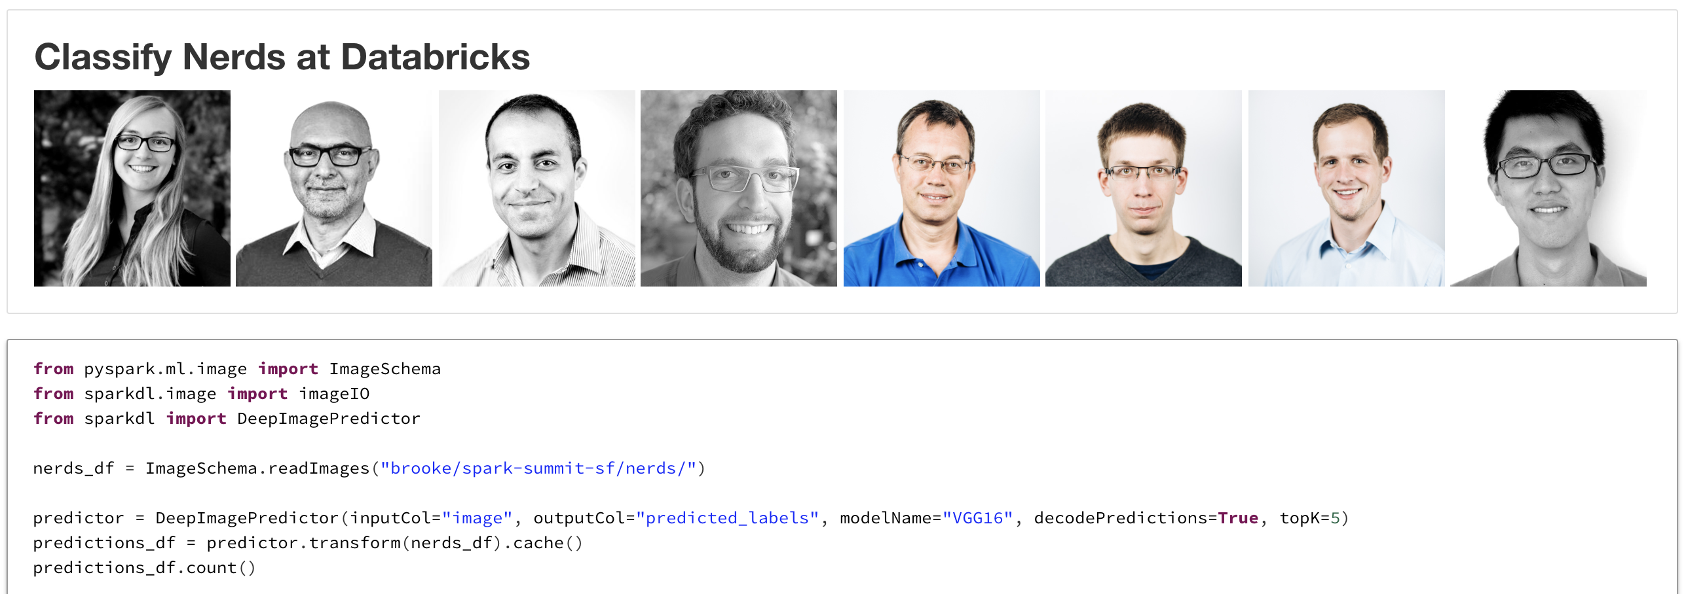
Example of using pretrained model for image Deep Image Predictor
Import the deep learning model
(show example run in Databricks)
Specify the model name to use the transformer

Slide 36
Example of transfer learning with DLP

Slide 37
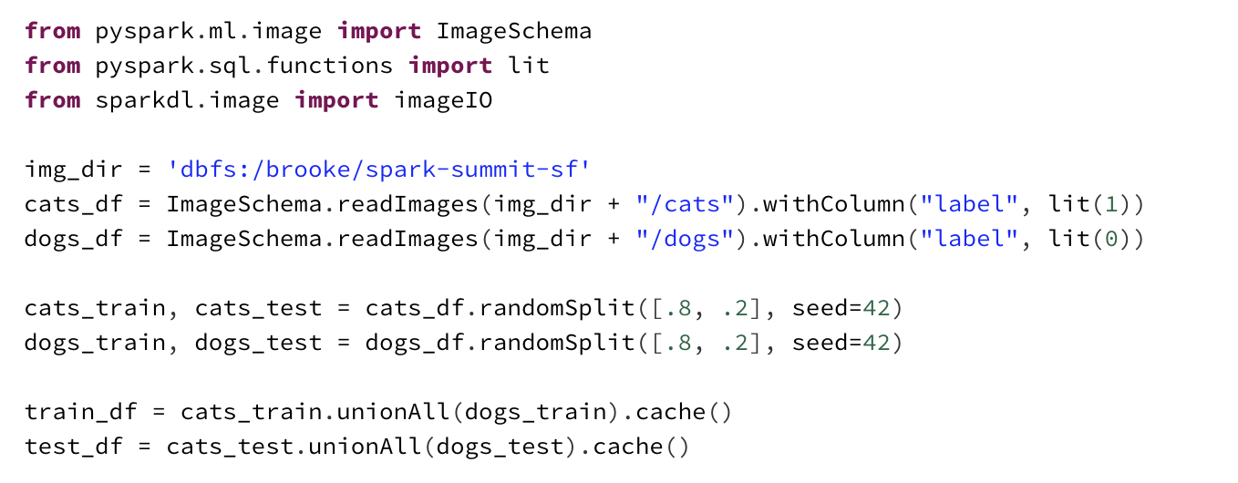
Example of transfer learning with DLP
(show example run in Databricks)

Slide 38
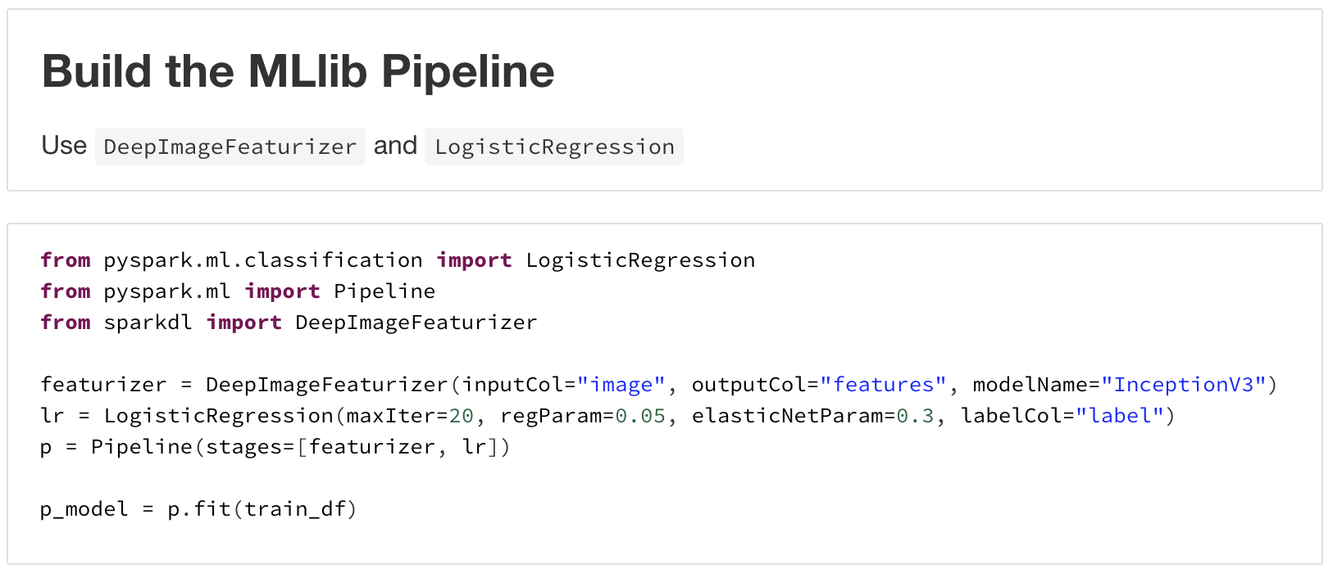
Example of transfer learning with DLP
(show example run in Databricks)

Slide 39
Thank you.

